Slide 1



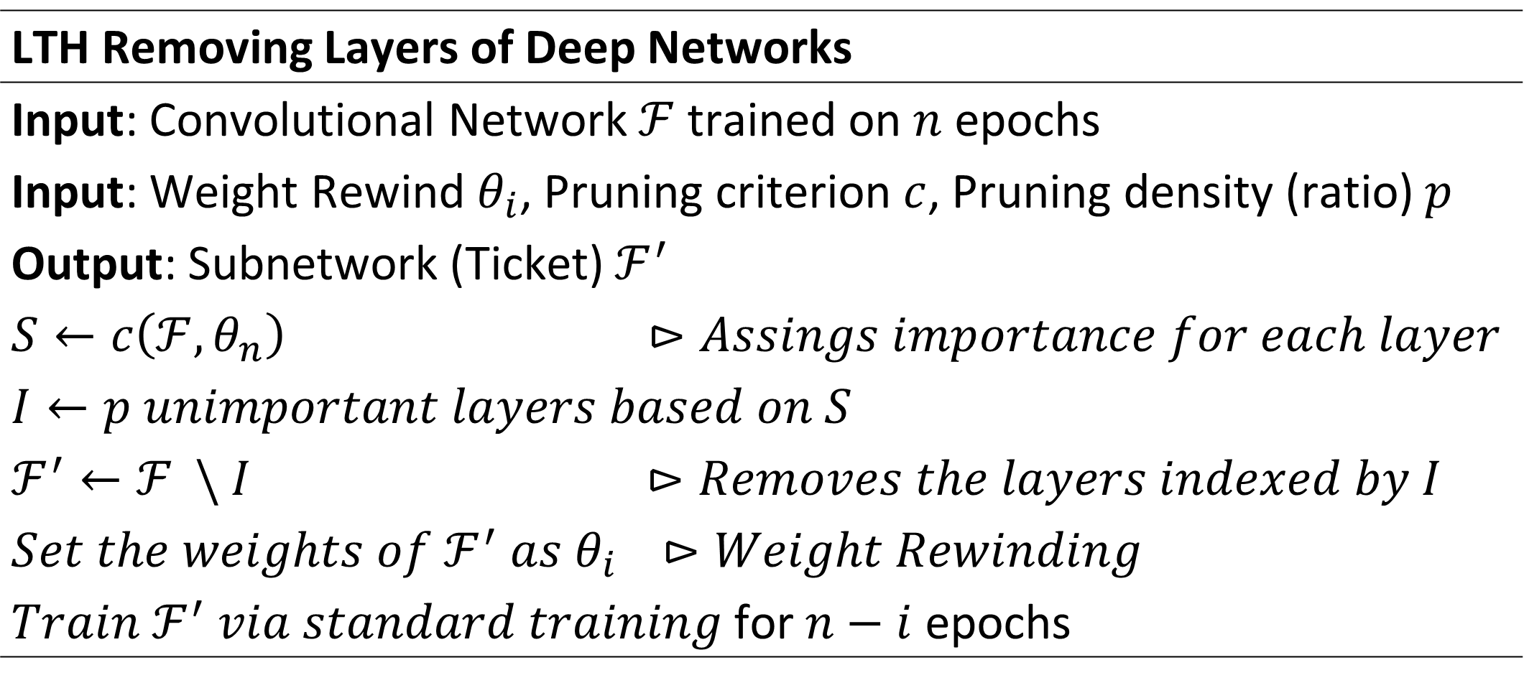

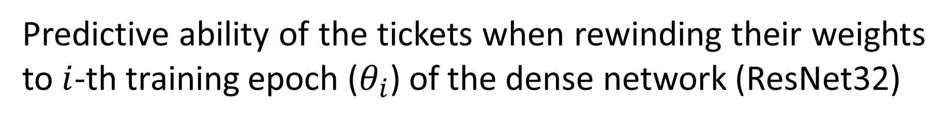
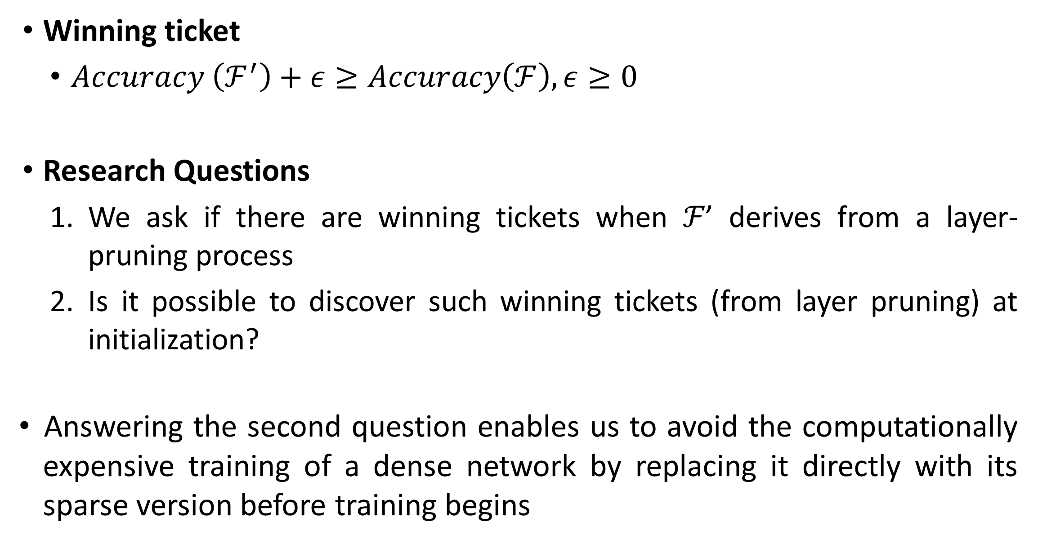
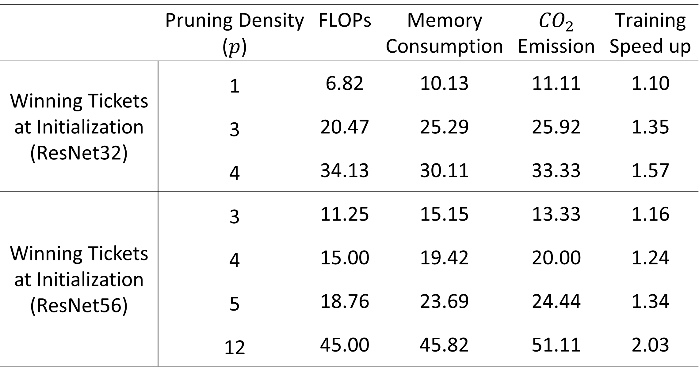
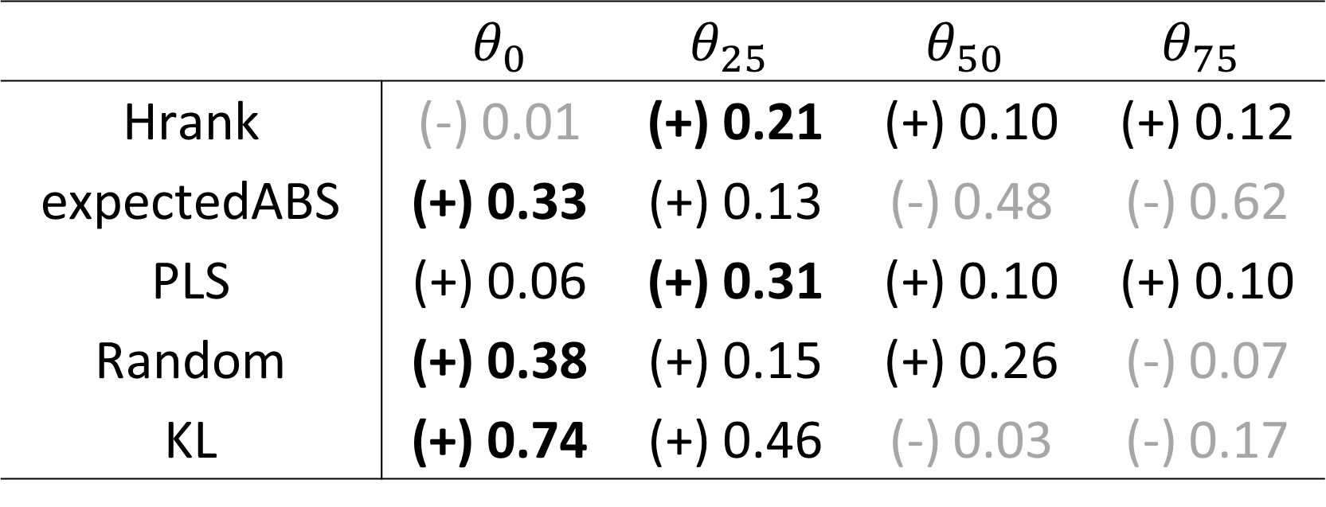

When Layers Play the Lottery, All Tickets Win at Initialization Artur Jordao, George de Araújo, Helena de Almeida Maia and Helio Pedrini 1 Escola Politécnica, Universidade de São Paulo 2 Institute of Computing, University of Campinas
1
2
2
2
Introduction
Experiments
Pruning is a standard technique for reducing the computational cost of deep networks
Lottery Tickets Hypothesis (LTH)
LTH reveals that inside a trained dense network exists sparse subnetworks (tickets) able to achieve similar accuracy (i.e., win the lottery – winning tickets)
Pruning at Initialization
It focuses on finding winning tickets without training a dense network
Studies on LTH and pruning at initialization share the following trend
Subnetworks come from weight or filter pruning
In this work, we investigate LTH and pruning at initialization from the lens of layer pruning
Experimental Setup
CIFAR-10 using ResNet32 and ResNet56
Predictive ability of the tickets when rewinding their weights to $i$-th training epoch ($θ_{i}$) of the dense network (ResNet32)
 | $$θ_{0}$$ | $$θ_{25}$$ | $$θ_{50}$$ | $$θ_{75}$$
Hrank | (-) 0.01 | (+) 0.21 | (+) 0.10 | (+) 0.12
expectedABS | (+) 0.33 | (+) 0.13 | (-) 0.48 | (-) 0.62
PLS | (+) 0.06 | (+) 0.31 | (+) 0.10 | (+) 0.10
Random | (+) 0.38 | (+) 0.15 | (+) 0.26 | (-) 0.07
KL | (+) 0.74 | (+) 0.46 | (-) 0.03 | (-) 0.17
70% of tickets became winning
Predictive ability of tickets from ResNet32 when our LTH discovers them at initialization
Pruning Density | SNIP | GraSP
1 | (+) 0.08 | (+) 0.40
2 | (+) 0.00 | (+) 0.72
3 | (-) 0.50 | (+) 0.34
4 | (-) 0.53 | (+) 0.41
5 | (-) 1.00 | (+) 0.12
Original Unstructured LTH (Pruning Weights)
Structured LTH (Pruning Neurons)
Our Structured LTH (Pruning Layers)
Preliminaries and Problem Statement
Performance gains of our winning tickets (layer pruning) at initialization
LTH Removing Layers of Deep Networks
Input: Convolutional Network $ℱ$ trained on $n$ epochs
Input: Weight Rewind $θ_{i}$, Pruning criterion $c$, Pruning density (ratio) $p$
Output: Subnetwork (Ticket) $ℱ^{′}$
$$S←c\left(ℱ, θ_{n}\right) ⊳Assings importance for each layer$$
$$I←p unimportant layers based on S$$
$$ℱ^{′}←ℱ \backslash I ⊳Removes the layers indexed by I$$
$Set the weights of$ $ℱ^{′}$ $as$ $θ_{i}$ $⊳Weight Rewinding$
$Train ℱ^{′}$ $via standard training$for $n−i$ epochs
 | Pruning Density ($p$) | FLOPs | Memory Consumption | $${CO}_{2}$$ Emission | Training Speed up
Winning Tickets at Initialization (ResNet32) | 1 | 6.82 | 10.13 | 11.11 | 1.10
 | 3 | 20.47 | 25.29 | 25.92 | 1.35
 | 4 | 34.13 | 30.11 | 33.33 | 1.57
Winning Tickets at Initialization (ResNet56) | 3 | 11.25 | 15.15 | 13.33 | 1.16
 | 4 | 15.00 | 19.42 | 20.00 | 1.24
 | 5 | 18.76 | 23.69 | 24.44 | 1.34
 | 12 | 45.00 | 45.82 | 51.11 | 2.03
Winning Tickets at Initialization
Input: Untrained Convolutional Network $ℱ$
Input: Pruning density (ratio) $p$
Input: Pruning criterion $c ⊳SNIP \left[1\right] or GraSP$[2]
Output: Subnetwork (Ticket) $ℱ^{′}$
$$S←c\left(ℱ, θ_{0}\right) ⊳Assings importance for each layer$$
$$I←p unimportant layers based on S$$
$$ℱ^{′}←ℱ \backslash I ⊳Removes the layers indexed by I$$
$Train ℱ^{′}$ via standard training for $n$ epochs
Conclusions
We verify the behavior of LTH when the pruning yields subnetworks (tickets) by removing layers from a dense network
We confirm that the tickets successfully become winning tickets
Our winning tickets at initialization speed up the learning phase by up to $2×$, reducing the carbon emission by up to $51\%$
Such achievements come at no additional price, as we extract winning tickets before training the dense network
We hope these benefits attract more research on LTH from the lens of layer pruning
Winning ticket
$Accuracy \left(ℱ^{′}\right)+ε≥Accuracy\left(ℱ\right), ε≥0$
Research Questions
We ask if there are winning tickets when ℱ’ derives from a layer-pruning process
Is it possible to discover such winning tickets (from layer pruning) at initialization?
Answering the second question enables us to avoid the computationally expensive training of a dense network by replacing it directly with its sparse version before training begins
Acknowledgements
This research was financed in part by the Coordenação de Aperfeiçoamento de Pessoal de Nível Superior - Brasil (CAPES) - Finance Code 001 – and by
the Brazilian National Council for Scientific and Technological Development (CNPq #304836/2022-2)
References
[1] Lee et al. Snip: single-shot network pruning based on connection sensitivity. In International Conference on Learning Representations (ICLR), 2019.
[2] Wang et al. Picking winning tickets before training by preserving gradient flow. In International Conference on Learning Representations (ICLR), 2020.
Notes:
Many advances in pruning leverage concepts from the LTH

